Slide 1
DBT-DATABRICKS

Slide 2
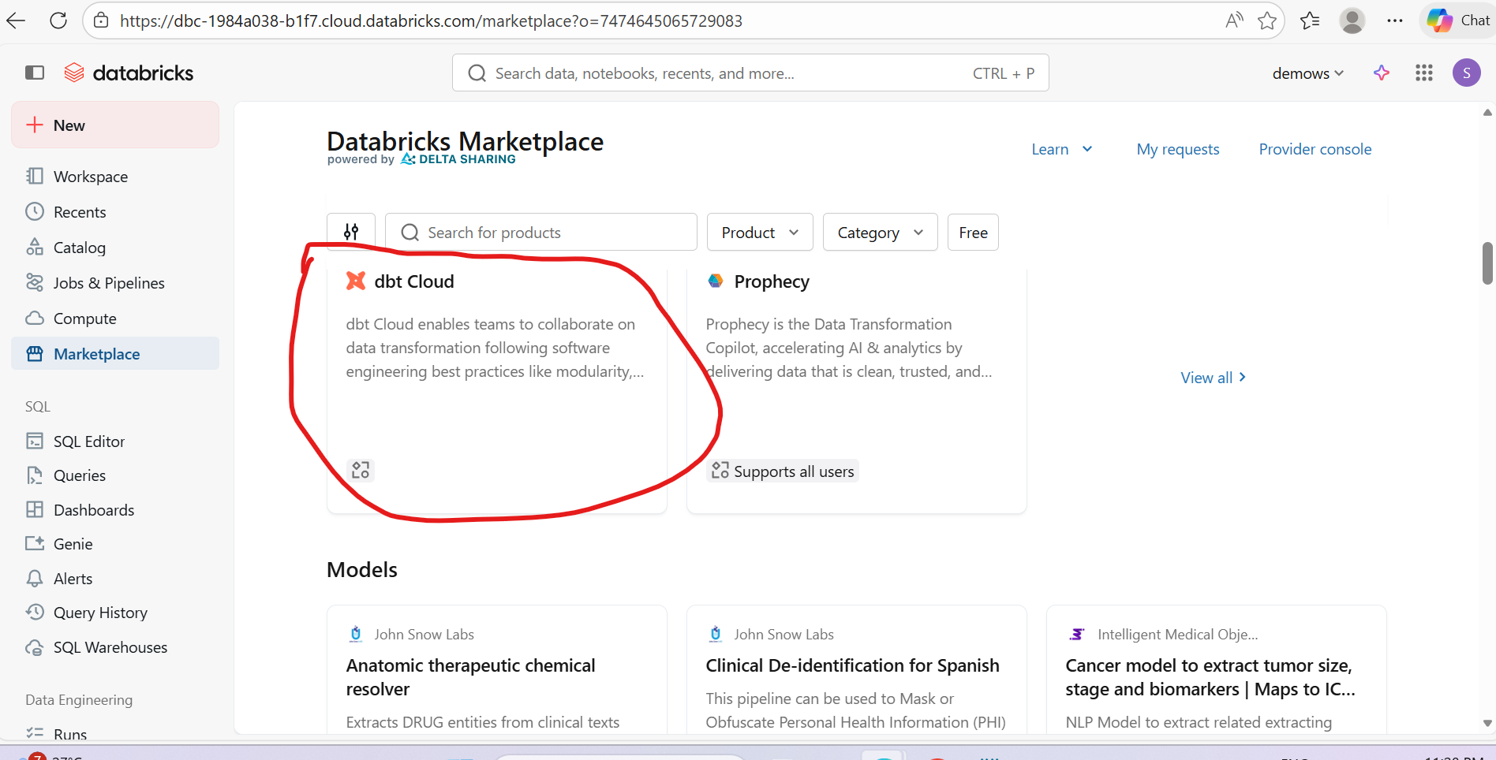

Slide 3
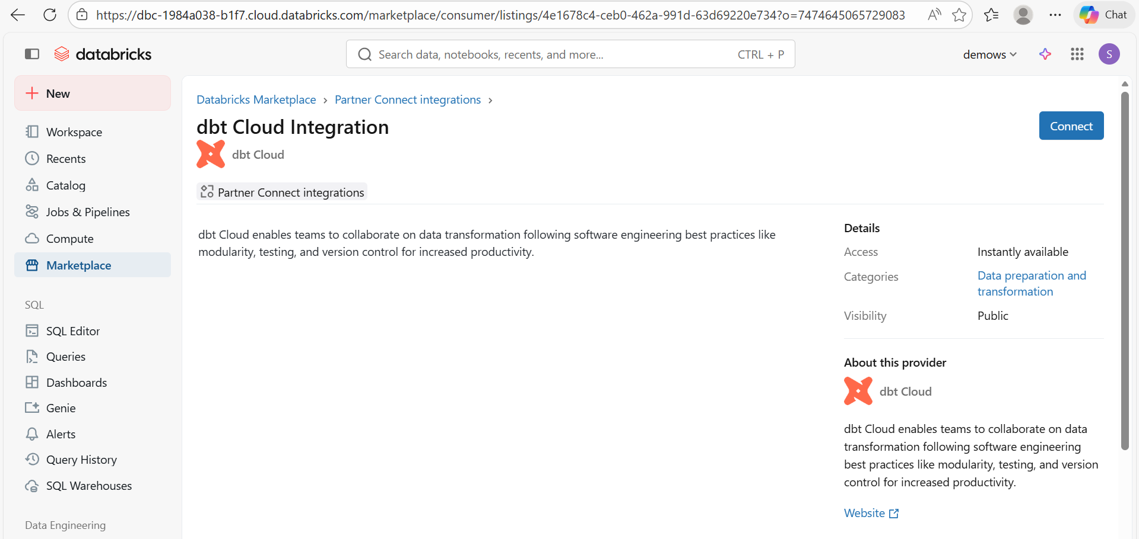

Slide 4
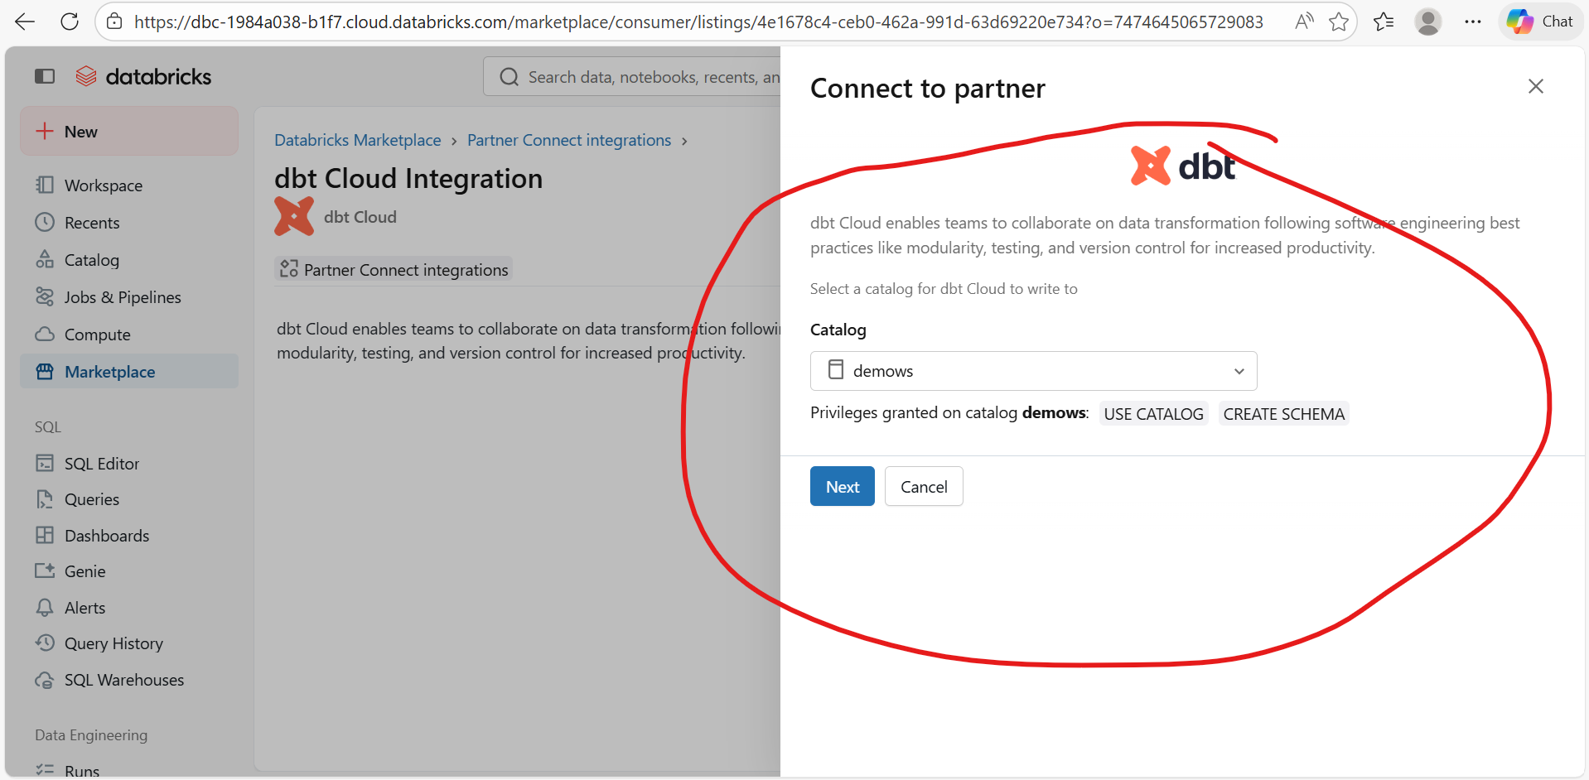

Slide 5
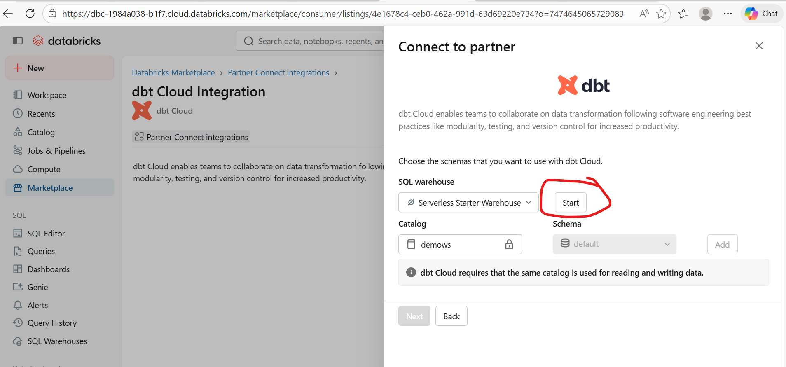

Slide 6
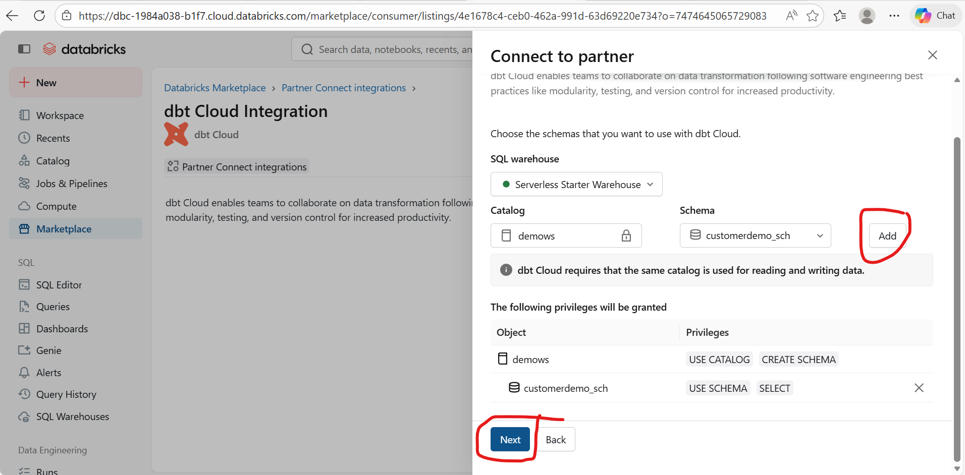
Start server warehouse and add catalog with schema

Slide 7
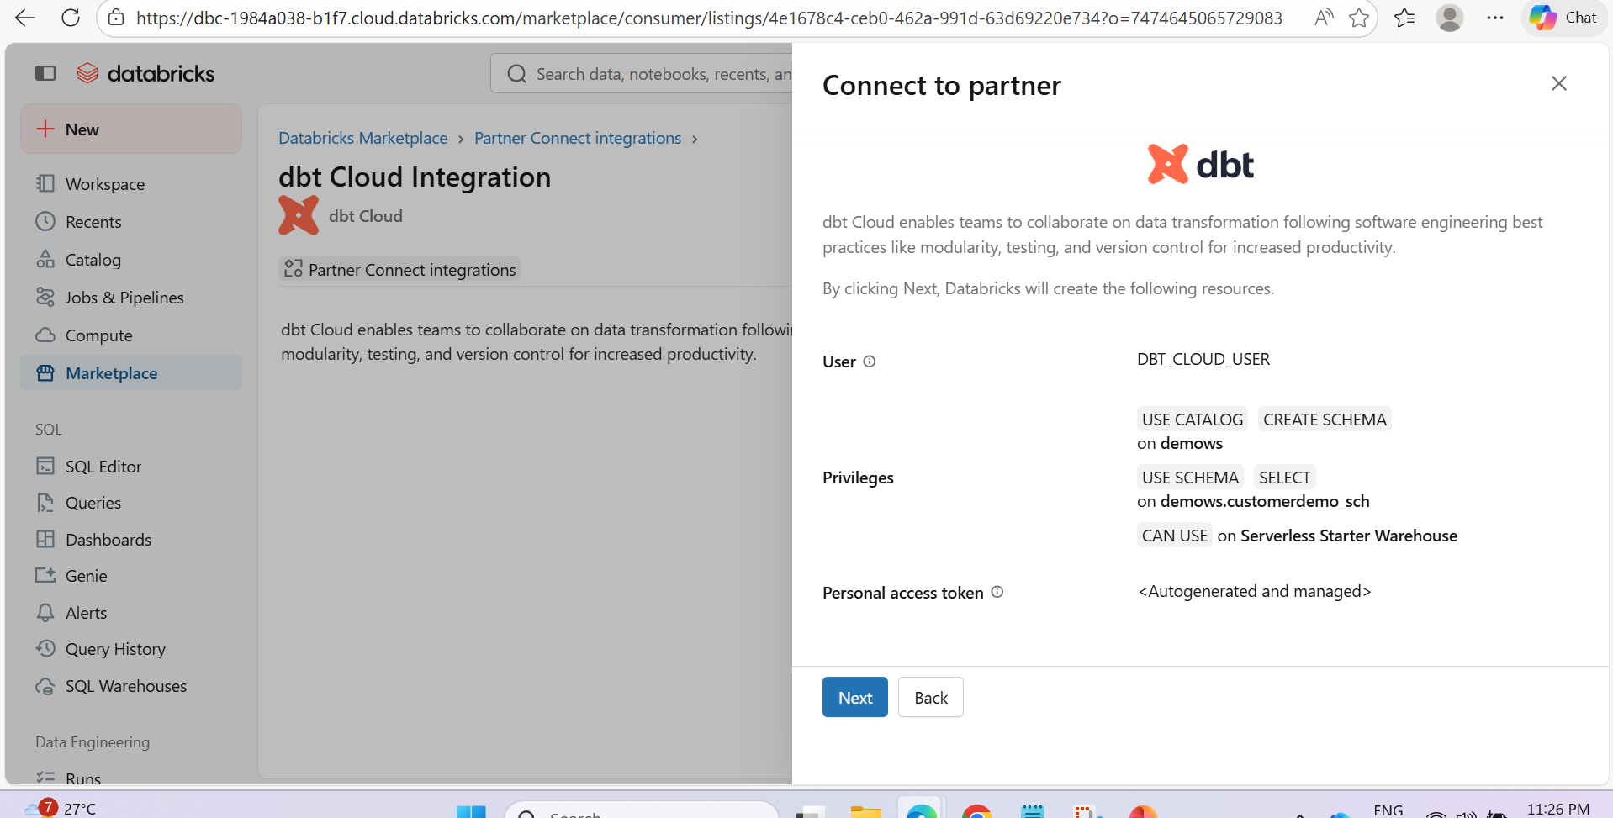

Slide 8
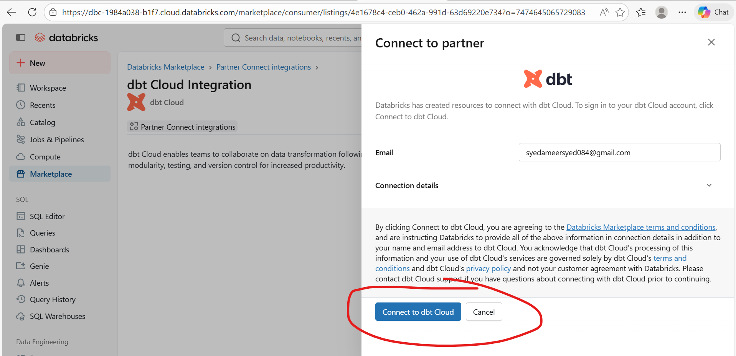

Slide 9
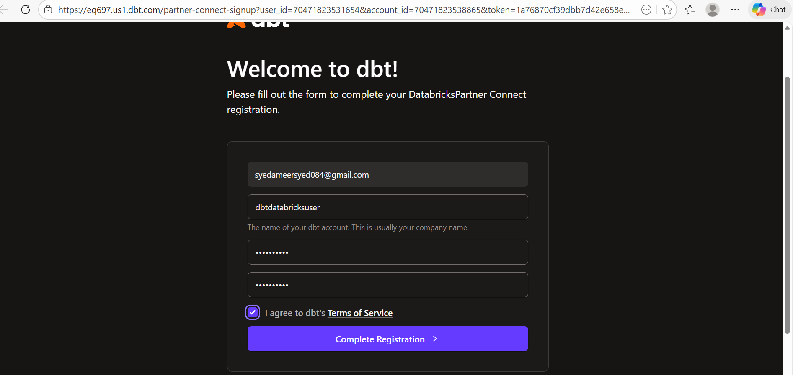

Slide 10
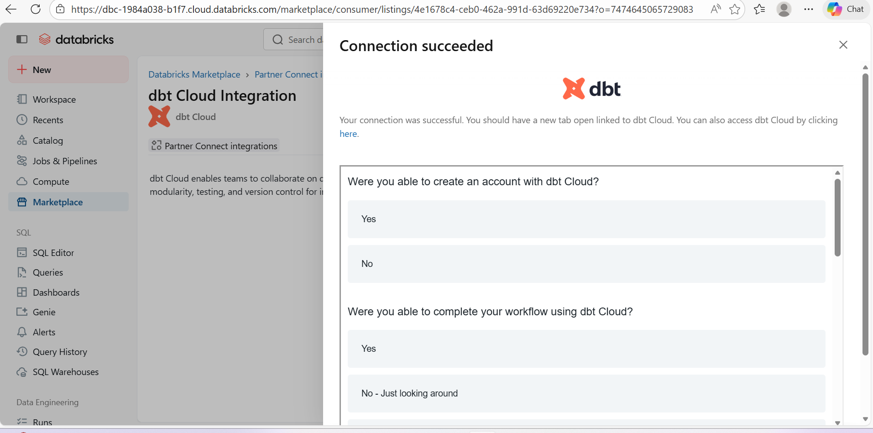

Slide 11
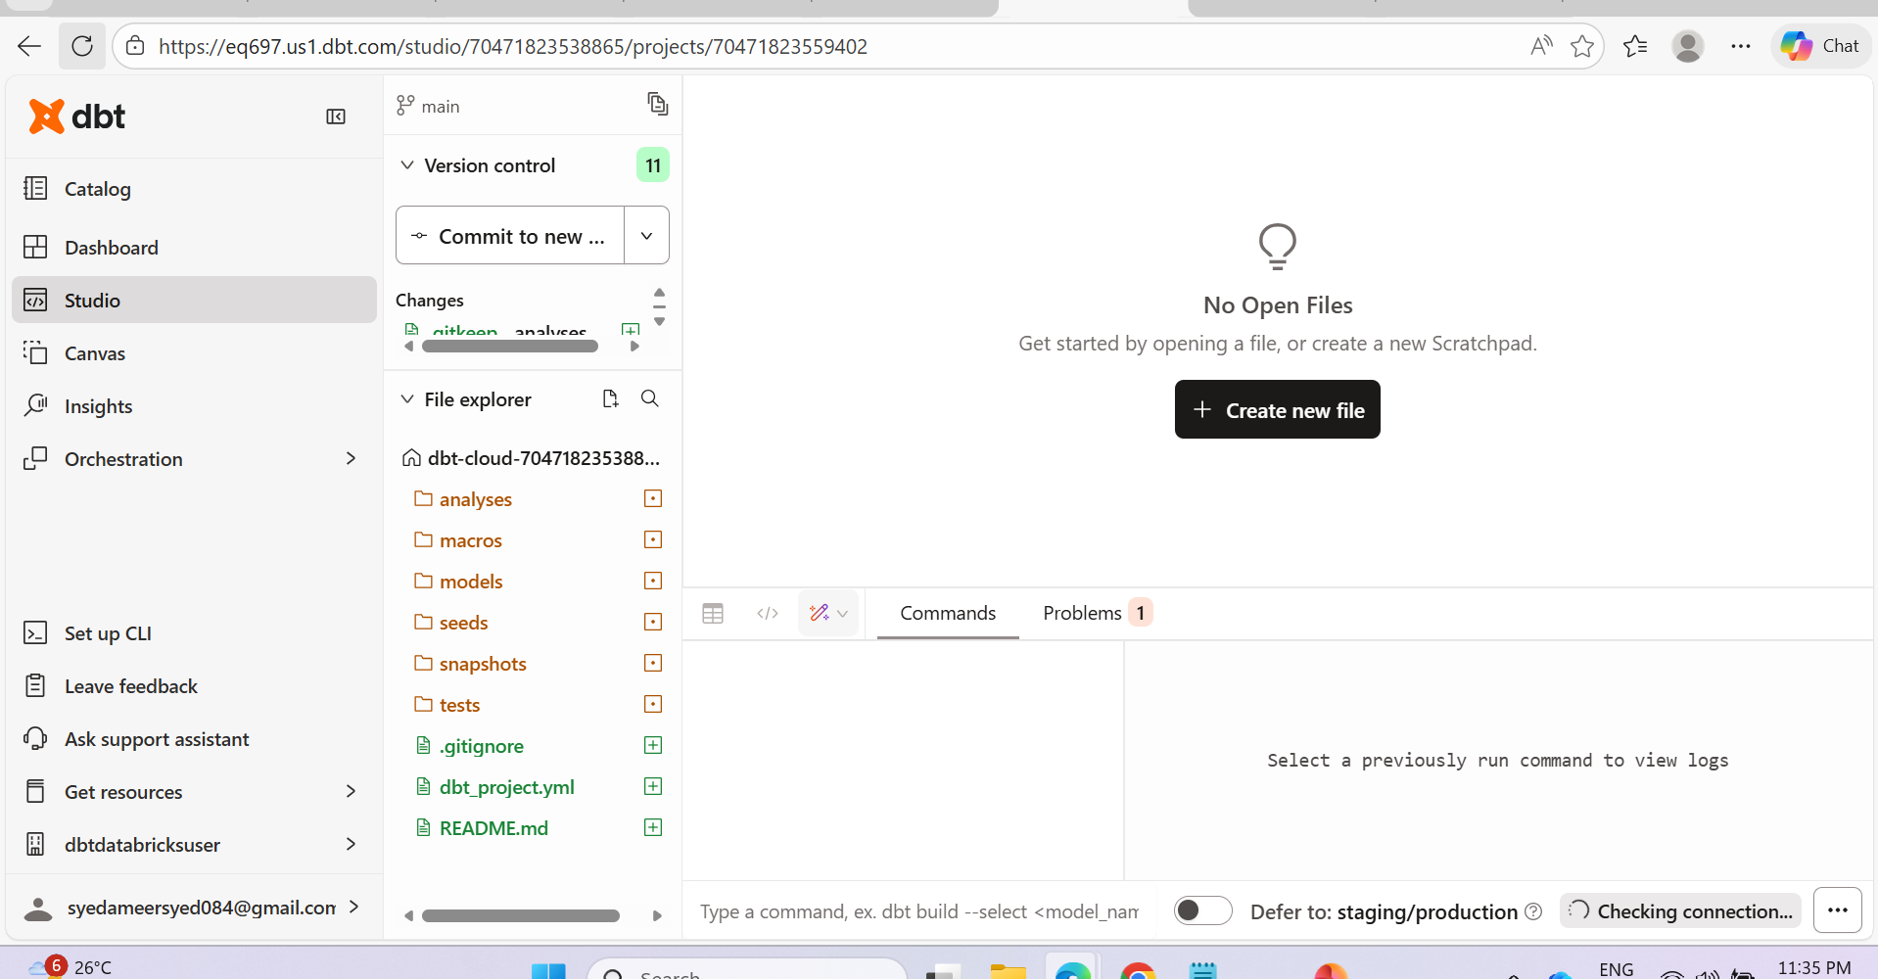

Slide 12
dbt + Databricks
🟢 Databricks = Compute + Storage (Delta tables)
🟠 dbt = Transformation layer (SQL-based modeling)
dbt creates models (tables/views) in Databricks.

Slide 13
STEP 1: Check Databricks Connection
In your screenshot bottom right shows:
👉 Checking connection...
Wait until it shows:
Connected
If it fails: Go to:
👉 Deploy → Environments → Check Databricks credentials

Slide 14
✅ STEP 2: Create Your First Model
Inside models/ folder:
Click:
models → Create new file
Name it:
customers.sql
Add example transformation:
select customer_id, upper(customer_name) as customer_name, country, current_timestamp() as load_time from {{ source('bronze', 'customers_raw') }}
Save file.

Slide 15
✅ STEP 3: Define Source (Very Important)
In models folder create:
sources.yml
Add:
version: 2 sources: - name: bronze database: your_catalog_name schema: bronze_schema tables: - name: customers_raw
⚠ Replace:
your_catalog_name
bronze_schema
With your Databricks Unity Catalog values.

Slide 16
✅ STEP 4: Run Model
In bottom command bar type:
dbt run
Or only that model:
dbt run --select customers
If successful:
✔ Table/View created in Databricks
Go to:
👉 Databricks → Catalog → Check table

Slide 17
Types of Transformations You Can Do in dbt
1️⃣ Basic Cleaning (Silver Layer)
select id, trim(name) as name, cast(amount as double) as amount from {{ ref('raw_orders') }} where amount is not null

Slide 18
2️⃣ Joins
select o.order_id, c.customer_name, o.amount from {{ ref('orders') }} o left join {{ ref('customers') }} c on o.customer_id = c.customer_id

Slide 19
3️⃣ Aggregations (Gold Layer)
select
customer_id,
sum(amount) as total_spent,
count(order_id) as total_orders
from {{ ref('orders_clean') }}
group by customer_id

Slide 20
4️⃣ Incremental Models (Very Important in Databricks)
In model file:
{{ config( materialized='incremental', unique_key='order_id' ) }} select * from {{ source('bronze', 'orders_raw') }} {% if is_incremental() %} where updated_at > (select max(updated_at) from {{ this }}) {% endif %}
This avoids full reload every time.

Slide 21
🔷 Materializations (Important)
In dbt + Databricks you can choose:
{{ config(materialized='table') }} {{ config(materialized='view') }} {{ config(materialized='incremental') }}
Default is view.

Slide 22
🔷 Production Structure (Recommended)
models/
├── bronze/
├── silver/
├── gold/
Example:
bronze → raw reference models
silver → cleaned joins
gold → aggregated reporting tables

Slide 23
🔷 After Running Models
In Databricks you can:
SELECT * FROM catalog.schema.customers;
You will see transformed data.

Slide 24
Load raw data to Databricks (Delta table)
Define source in dbt
Create transformation SQL model
Run dbt run
Validate in Databricks
Add tests (dbt test)
Schedule job in dbt Cloud

